Slide 1
Comparative study on Clinical Concept Extraction
Team members:
Meghna Kashyap (181IT127)
Udbhav Bisarya (181IT150)
Vishwas Parekh (181IT252)

Slide 2
Introduction
Electronic health records (EHRs) have been widely viewed to have great potential to improve clinical research and bring about advances in healthcare technology.
A significant portion of clinical extraction is found as free text, and we need to achieve the goal of “meaningful information”, transforming the EHR data into actionable knowledge.
The solution to this is to replace these manual methods with autonomous computational extraction.

Slide 3
Issues and Challenges
Extracting information from Electronic Health Records into meaningful data
Only portions of datasets are available due to medical data being sensitive information, which hinders research.
Traditional ML approaches do not work well, as identifying and labeling named entities needs understanding of the context of a sentence and sequence of the word labels in it

Slide 4
Motivation
Understanding of extraction of clinical concepts from health records is the main goal of this project.
This is an essential step for turning the unstructured data in any clinical note given by a doctor/hospital into structured information which can benefit a patient more.
In order to gain more knowledge in this field, we took it up as our course project.

Slide 5
Literature Review
Paper | Authors | Advantage | Limitations
Bidirectional LSTM-CRF for Clinical Concept Extraction | Yonghui Wu, Ph.D, Jun Xu, Ph.D, Min Jiang, M.S, Yaoyun Zhang, Ph.D and Hua Xu, Ph.D | This paper uses BiLSTM for NER, thus giving us a solid base for the project. | The use of different embedding techniques leads to poor results
Clinical Concept Extraction with Contextual Word Embedding | Henghui Zhu, Ioannis Ch. Paschalidis, Amir Tahmasebi | They have used the ELMo as the word embedding model, and have specifically trained it for the clinical domain. | As the dataset contains sensitive information, only a part of it is made available. They didn’t explore other models that could have performed better for NER.

Slide 6
Outcome of literature review
On understanding various papers, we gained ideas on different embedding techniques.
We gained understanding of the state of the art ELMo model.
Understood implementation of Natural Language Processing (NLP) and more specifically, Named Entity Recognition (NER) associated with Machine Learning.

Slide 7
Problem Statement
The extraction of clinical concepts from health records has been successful in the past few years with a lot of models based on NLP, but due to the heterogeneous nature of Health Record data meant that no one model has been successful globally.
The aim of this project is the automation of extraction of clinical concepts from health records using word embeddings.

Slide 8
Research Objectives
Modification of existing repository and understanding of the working of the ELMo model.
Creation of new models for Named Entity Recognition(NER).
Comparative study of base paper and new models created.

Slide 9
Methodology
The existing repository has been setup and modified depending on our requirements.
Using the pretrained ELMo model provided in the base paper, the embeddings will be used as inputs to the new BiLSTM-CNN model.
Using the pretrained ELMo model provided in the base paper, the embeddings will be used as inputs to the new BiLSTM-CNN-CRF model.
Comparing the results of the new models with the model proposed in the base paper.

Slide 10
Dataset
We use the same dataset as the reference paper, which is the data provided by the 2010 i2b2/VA challenge for training the clinical concept extraction system.
There are three clinical concepts annotated in this corpus: problems, tests, and treatments.
corpus | reports | sentences | tokens | problem | treatment | test
training | 170 | 16,414 | 149,541 | 7,073 | 4,844 | 4,606
test | 256 | 27,763 | 267,249 | 12,592 | 9,344 | 9,225
Notes:
Due to the restrictions introduced by Institutional Review Board (IRB), only a portion of data from the original dataset is available. The released dataset consists of clinical summaries from three different medical sites: Partners Healthcare, Beth Israel Deaconess Medical Center, and the University of Pittsburgh Medical Center. There are three clinical concepts annotated in this corpus: problems, tests, and treatments. There are 170 summaries for training and 256 for test.

Slide 11
Proposed Modifications
Use different ML models for Named Entity Recognition to compare the performance of the models for clinical concept extraction.
Use a bidirectional LSTM-CNN model
Use a bidirectional LSTM-CNN-CRF model
Notes:
Since the ELMo model that has been used by the paper is considered a huge improvement on the general ELMo model, we decided to change the prediction model and are going to try using these state-of-the-art models namely BiLSTM-CNN and BiLSTM-CNN-CRF. We think that since these models have not been used with the specific ELMo model, we can achieve better results and a good F!-score and compare with the base paper.

Slide 12
Work Done
Trained a word embedding model on a mixture of clinical reports.
Used a bidirectional LSTM-CRF model for clinical concept extraction using the word embedding model.
Notes:
So currently, we have got the base paper repo to work and since it was using tensorflow1, many modifications had to be made and we also had to adjust the repository so that it works for our use case. Our next steps will be to implement our proposed modifications and compare the precision,recall and F1-score with that achieved in the base paper.

Slide 13
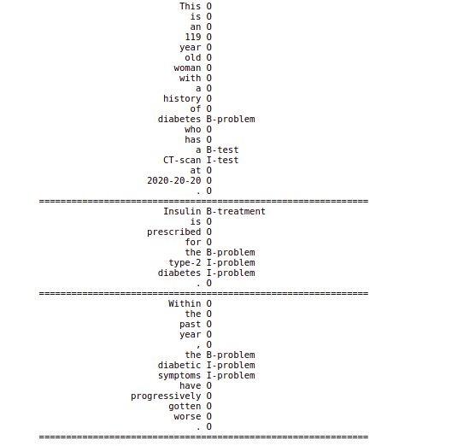
Results and Analysis
The B- indicates “before” as a prefix and I- indicates “is” prefix
The types of clinical annotations used are - problem, test and treatment.
Notes:
We ran the code and got this output. For each word a label is assigned indicating the context. Since ELMo is a bidirectional language model, we can figure out problems, tests and treatments with a good F1-score.

Slide 14
Base Paper
OTHER REFERENCES
Bidirectional LSTM-CRF for clinical concept extraction.
Chalapathy, Raghavendra, Ehsan Zare Borzeshi, and Massimo Piccardi.
Named Entity Recognition
ELMo
Clinical concept extraction with contextual word embedding
-Zhu, Henghui, Ioannis Ch Paschalidis, and Amir Tahmasebi.

Slide 15
Thank You

